Slide 2
Scale-Up
Presented BY:
Pankaj Savantre
Tamanna Soni
Shreedevi S Shahapur

Slide 3

TABLE OF CONTENT
Problem Statement
Tools used
Architecture of application
ER Diagram
Workflow
Features Used
Demo
Notes:
Gamified & Enganemnt

Slide 4
PROBLEM STATEMENT: Scale Up System would be able to deliver daily needs as grocery items , dairy products, etc taking from local merchants and delivering them to the customers. Although the basic needs of customer will be fulfilled by local merchants by delivering the products at doorsteps : 1.Registering Local Merchants and customers on Scale-Up. 2.Taking the order from customers. 3.Showing available Products. 4.Adding items to cart . 5.Confirming orders.

Slide 5
Tools Used
Java
MySQL
Tomcat Server
Eclipse
Spring tool suite

Slide 6
Features Used:
Core Java​ Exceptions​ Handling JSP​ CSS HTML Bootstrap Spring boot ​

Slide 7
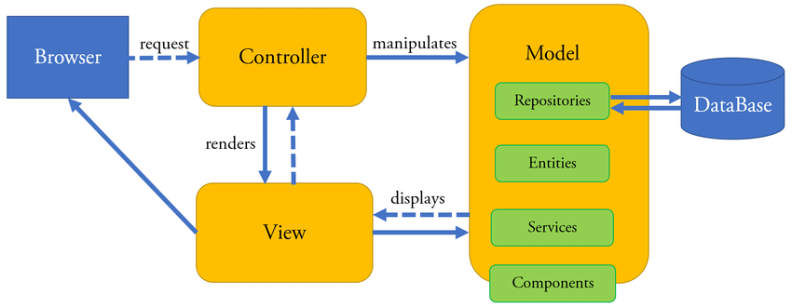
Architecture of Application:

Slide 8
1.Merchant: They can add their products . They can Edit, Search and delete product
Overview of Scale –Up
2.Customer: Customers can view the products available.
They can view the description of Product
They can add product to cart

Slide 9
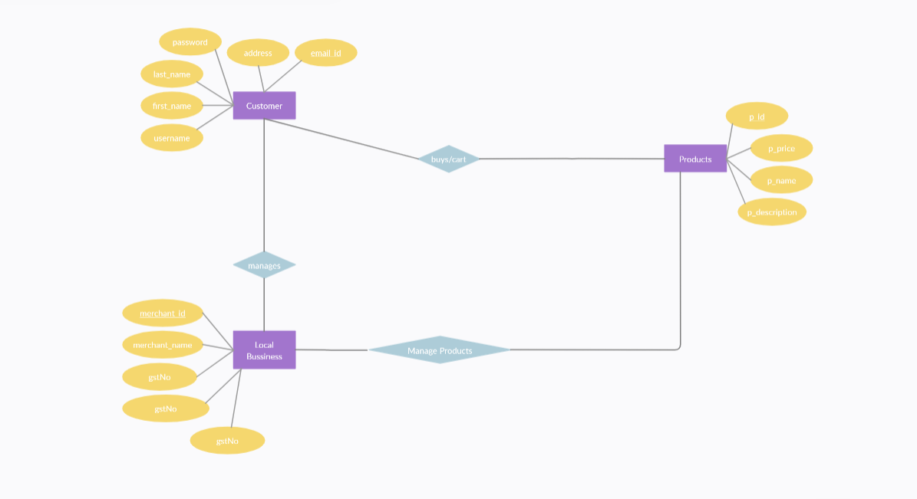
ER-Diagram:

Slide 10
WorkFlow:

Slide 11
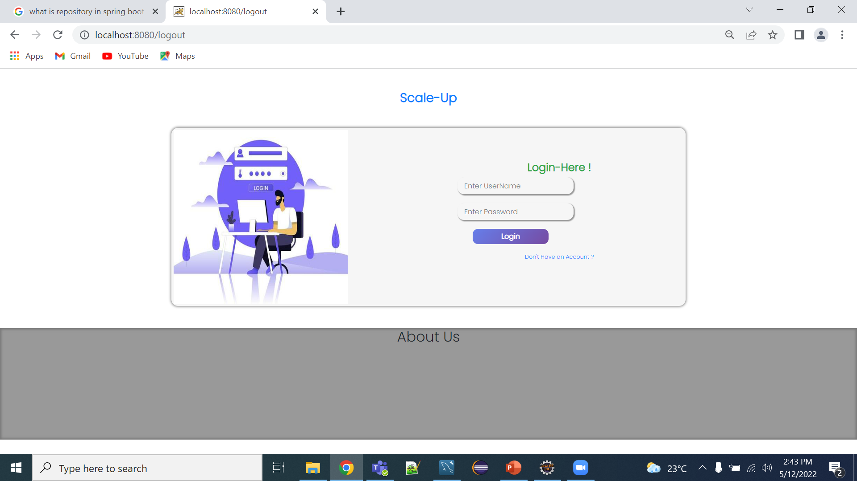
SCREENSHOTS: 1. Customer Module Login Page

Slide 12
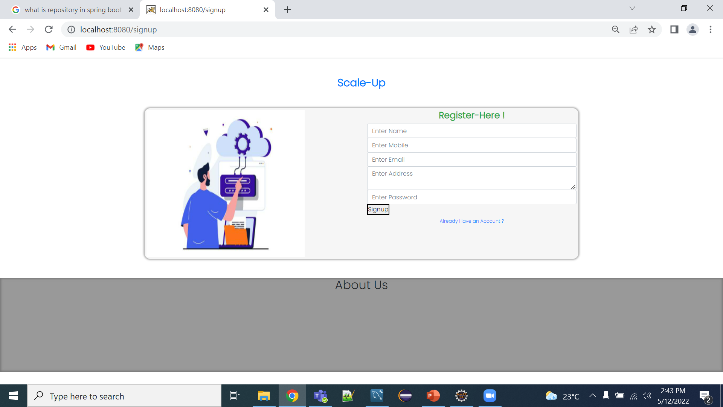
SCREENSHOTS: 1. SignUp Page

Slide 13
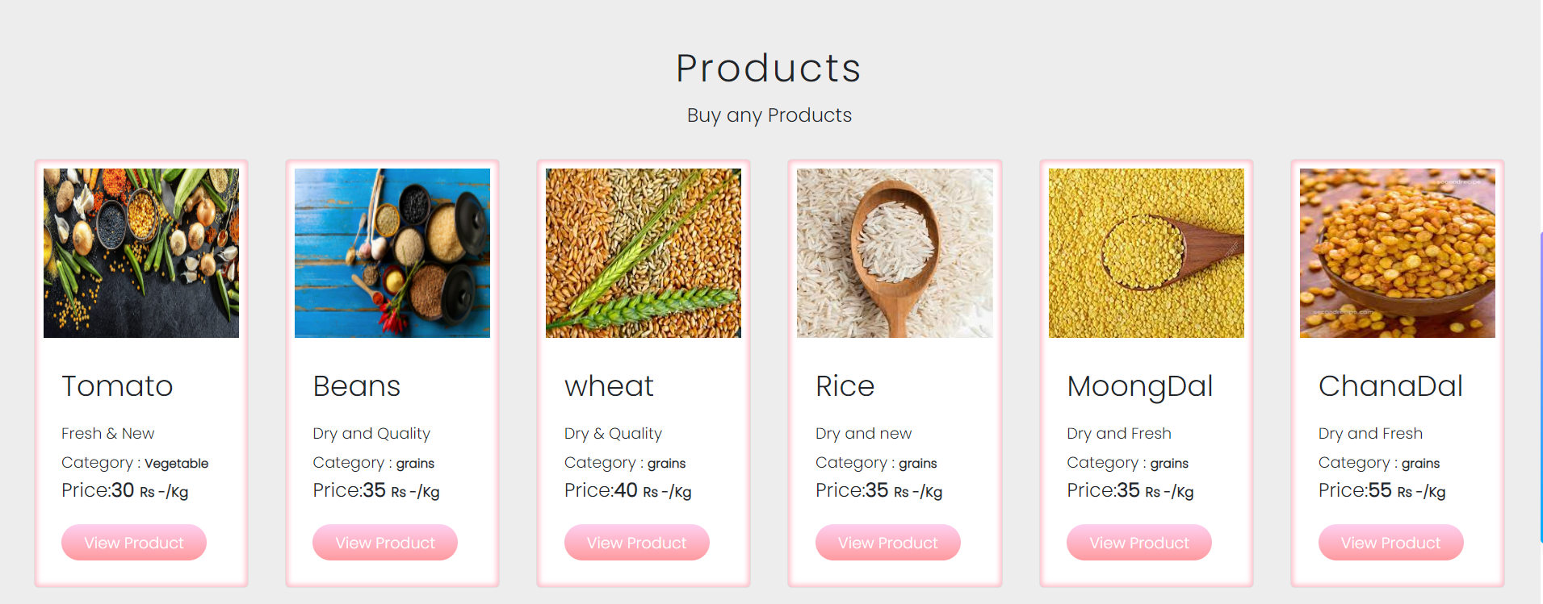
SCREENSHOTS: 1. Home Screen

Slide 14
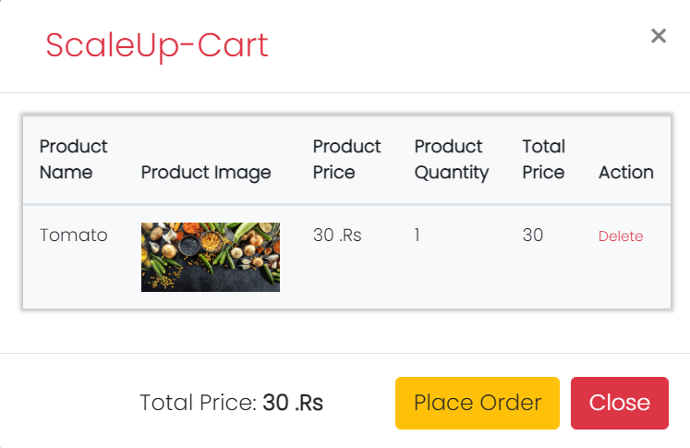
SCREENSHOTS: 1. Add to Cart Screen

Slide 15
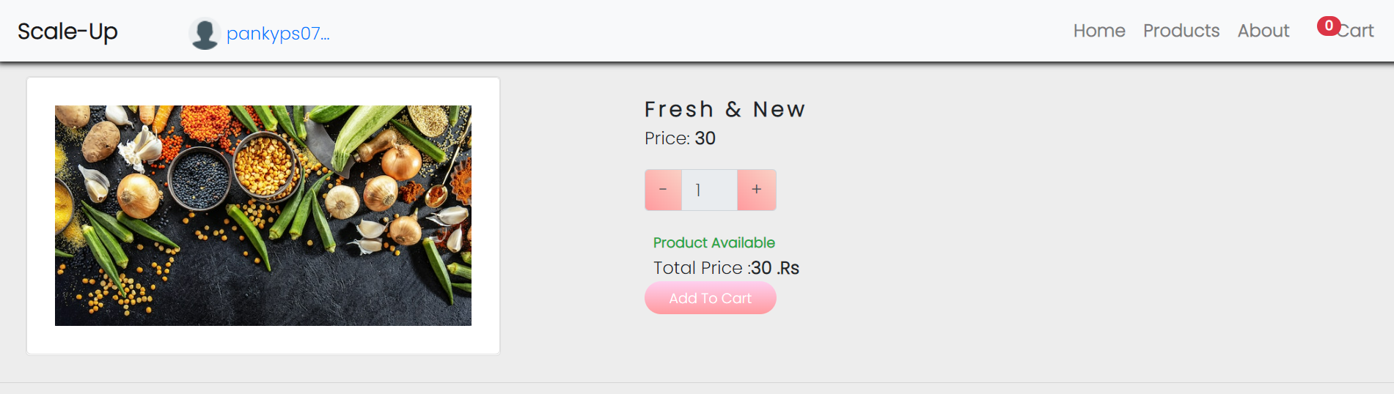
SCREENSHOTS: 1. Product Description Screen

Slide 16
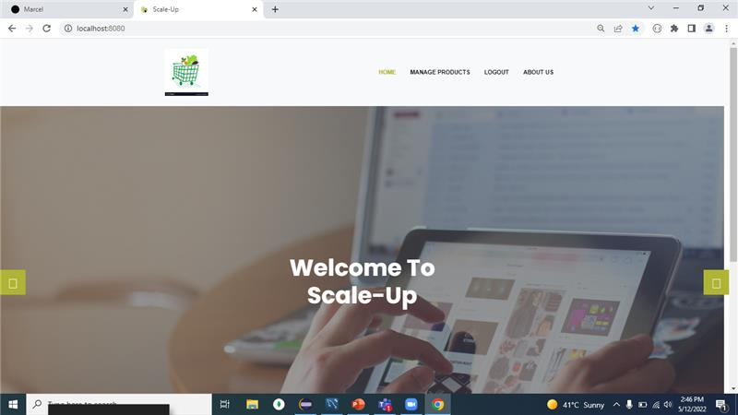
SCREENSHOTS: 1. Merchant Module Home Screen

Slide 17
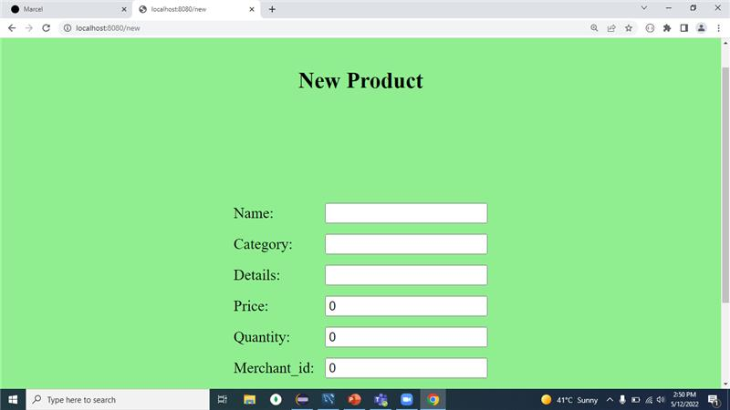
SCREENSHOTS: 1. Add New Product Screen

Slide 18
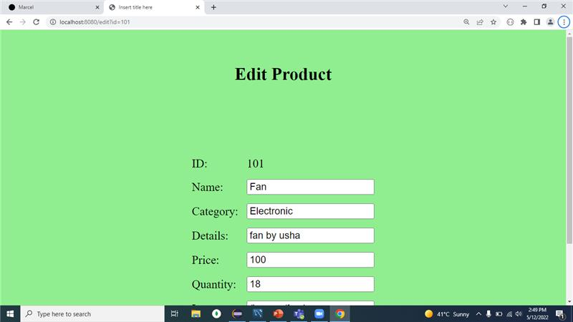
SCREENSHOTS: 1. Edit Product Screen

Slide 19
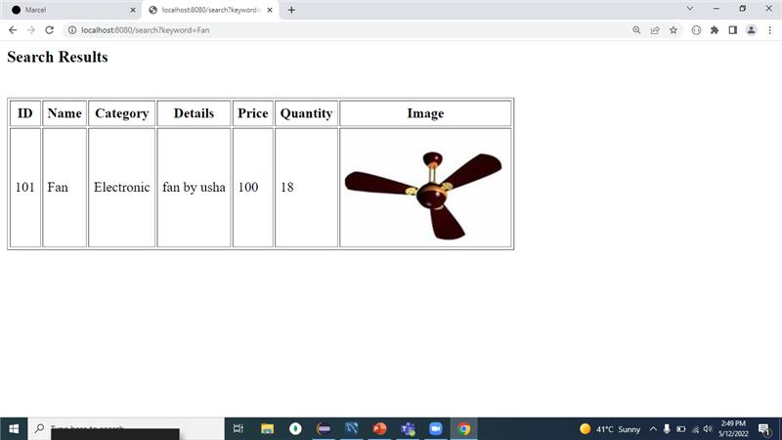
SCREENSHOTS: 1. Search Product Screen

Slide 20
Conclusion: In this pandemic situation this website is very helpful to local merchant to sell there goods online and customer can get things without going out from home . This website provides a online platform to merchants to do their business without maintaining and marketing any website which will benefit them to scale-up their business . It has a facility of Merchant portal and customer portal.

Slide 21
DEMO

Slide 22
Q & A

Slide 23
Thank You

